Slide 1
مِ يْ حِ رَّ لا نِ مٰ حْ رَّ لا هِ للا مِ سْ ب

Slide 2


Natural Language Processing (NLP)
Lecture 04 – Data and Annotations
Instructor:
Dr. Jawad Shafi

Slide 3

لِِ تَْ َ خْ اوَ لِْ ِ رْ خِ مَّ ُهَّللا
Dua – Take Help from Allah Before Starting Any Task
ۖ اَنتَ مْ َّلَع امَ لََّ اِ اَنَل لَْ ْ عِ لََ كَ َناحَ بْ .سيمُ كِ حَ ْلا يمُ لِ عَ ْلا تَ ْنأَ كَ َّنا
يرِ دْ صَ لِِ حْ شَْ ْ ا بِِّ ر يرِ مْ اَ لِِ سِْ ِِّ َيو
نِِ اسَ لِ نْ مِ ةً دَ قْ عُ لْ ُلحْ او لِِ وْ َق اوهُ قَ فْ َي
Dr. Rao Muhammad Adeel Nawab
3

Slide 4
Corpus / Dataset
Dr. Rao Muhammad Adeel Nawab
4

Slide 5



Introduction
What is Data?
Data / Text is a backbone of NLP or
The starting point of NLP research is a Corpus / Dataset
Myth
Outcome
i.e. why NLP Approaches are also called Data Driven
Dr. Rao Muhammad Adeel Nawab
5

Slide 6


Objective
To develop Intelligent NLP Programs (or Models) using Machine Learning Approach (or Data Driven Approach), we need
Large amount of Data
High-quality Data
Balanced Data
Dr. Rao Muhammad Adeel Nawab
5

Slide 7







Corpus / Dataset in NLP
In NLP, Corpus / Dataset is defined as a collection of
Real-world Data in Machine-readable Format
Definition
Purpose
To enable a NLP to learn from Corpus / Dataset to perform various useful tasks
Without Data, NLP cannot learn
Importan
Dr. Rao Muhammad Adeel Nawab
5

Slide 8
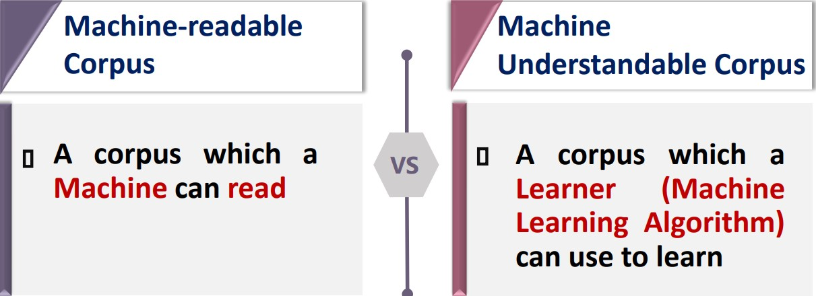


Machine-readable vs Machine Understandable Corpus
Dr. Rao Muhammad Adeel Nawab
5

Slide 9
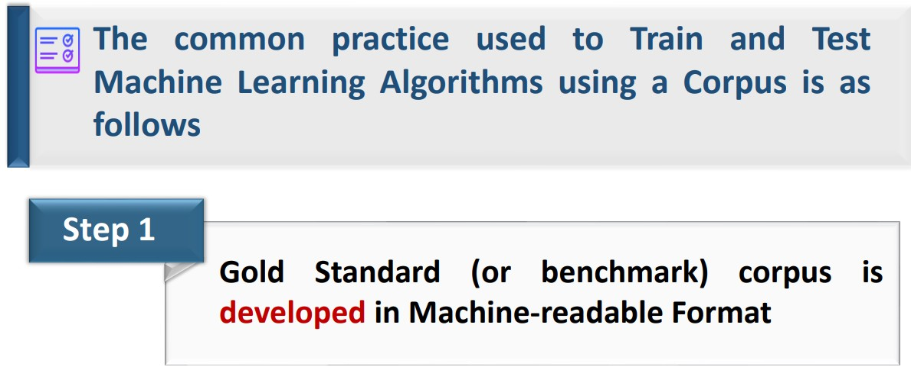
Using Corpus for Machine Learning - Common Practice
Dr. Rao Muhammad Adeel Nawab
5

Slide 10
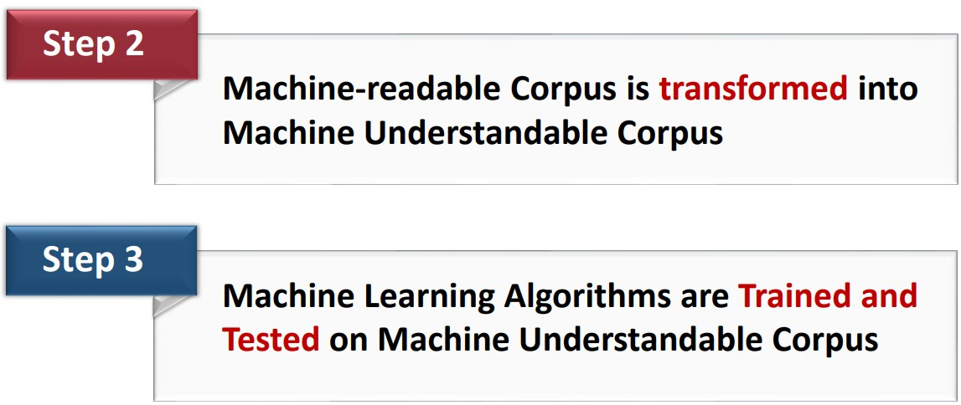









Machine-readable vs Machine Understandable Corpus (conti.)
2
3
4
5
Speech Recognition
NL
Understanding
NL
Generation
Components
Output
Dr. Rao Muhammad Adeel Nawab

Slide 11

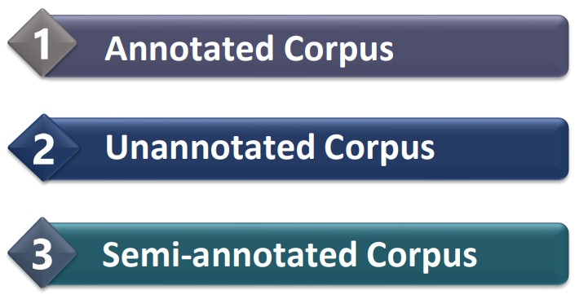

Types of Corpus / Dataset – NLP
The Corpus / Dataset used in NLP can be mainly categorized:
Wholly Derived
Types
Dr. Rao Muhammad Adeel Nawab

Slide 12
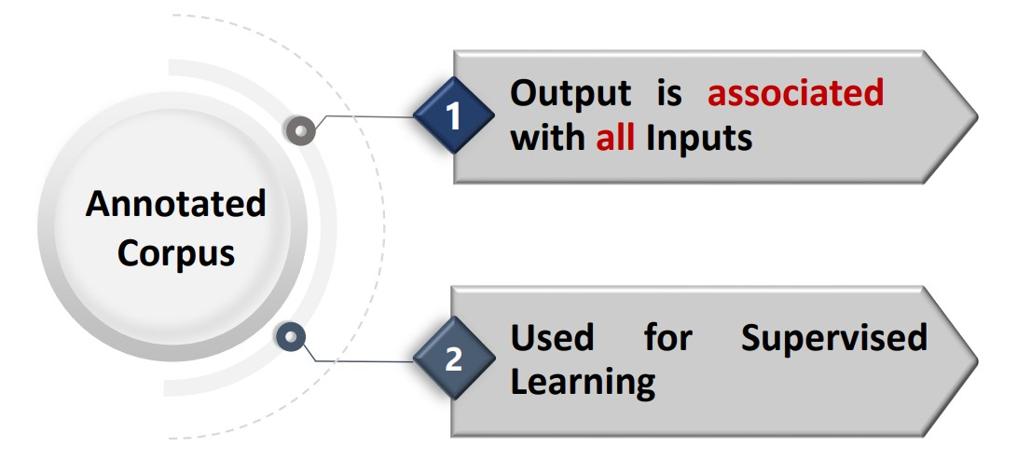

Types of Corpus / Dataset – NLP (Conti.)
Wholly Derived
rocess
Dr. Rao Muhammad Adeel Nawab

Slide 13

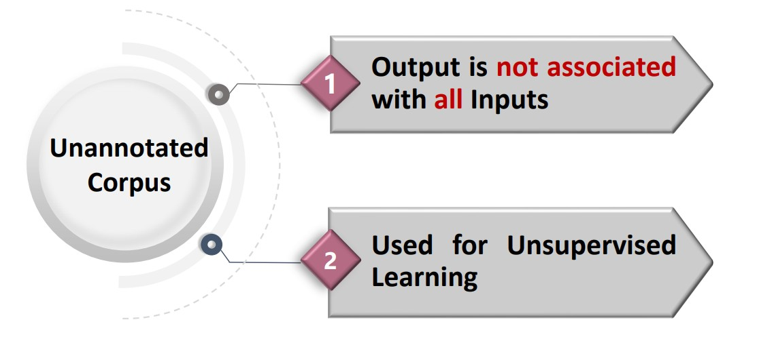


Types of Corpus / Dataset – NLP (Conti.)
Wholly Derived
rocess
Dr. Rao Muhammad Adeel Nawab

Slide 14
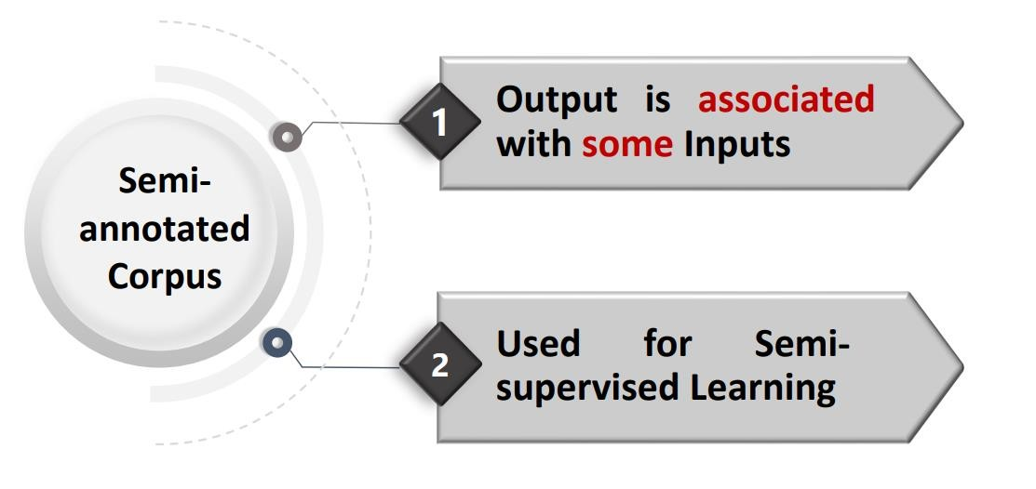
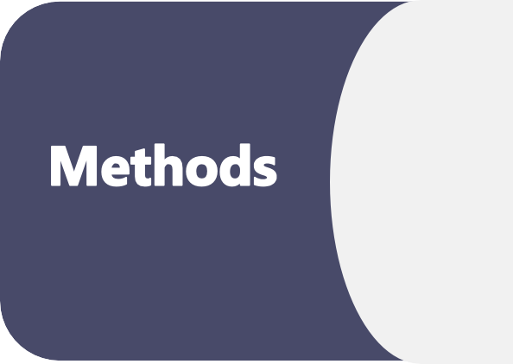

Types of Corpus / Dataset – NLP (Conti.)
Methods
Survey Methodology
Dr. Rao Muhammad Adeel Nawab

Slide 15
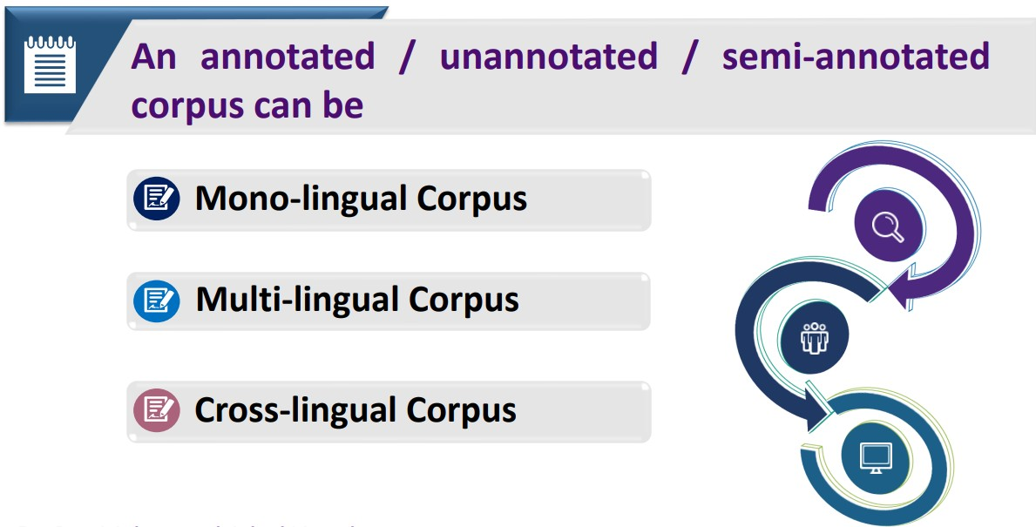
Types of Corpus / Dataset – NLP (Conti.)
Wholly Derived
Dr. Rao Muhammad Adeel Nawab

Slide 16
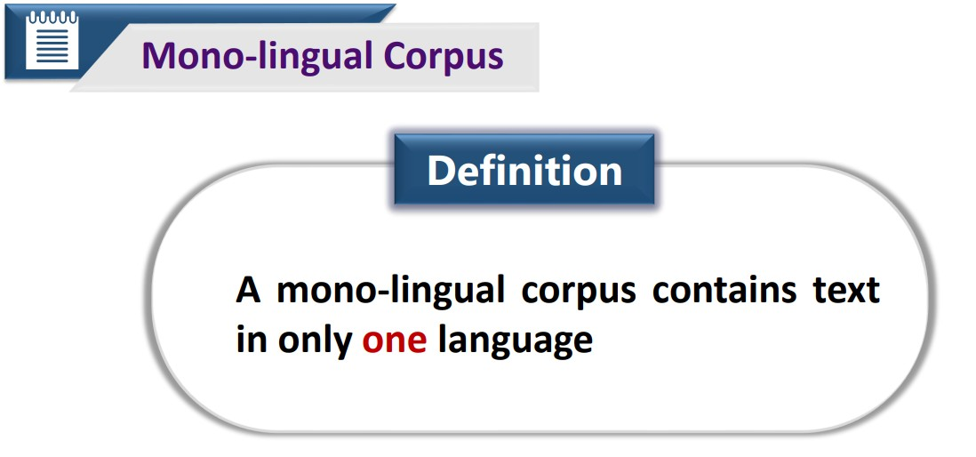
Types of Corpus / Dataset – NLP (Conti.)
Wholly Derived
Dr. Rao Muhammad Adeel Nawab

Slide 17
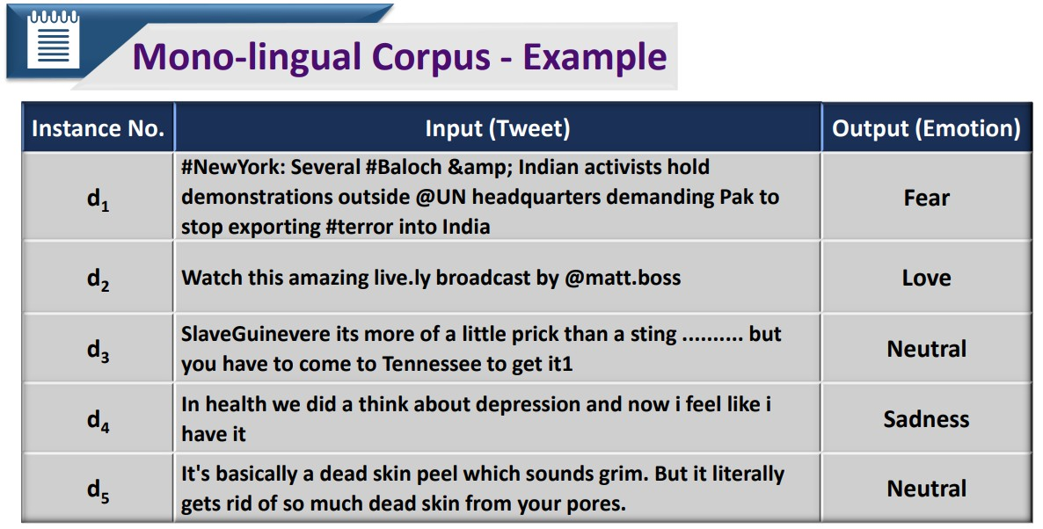
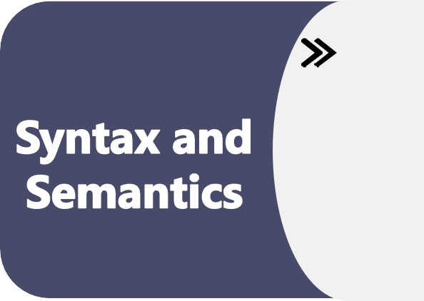

Types of Corpus / Dataset – NLP (Conti.)
Syntax and Semantics
Discourse & Speech
Dr. Rao Muhammad Adeel Nawab

Slide 18
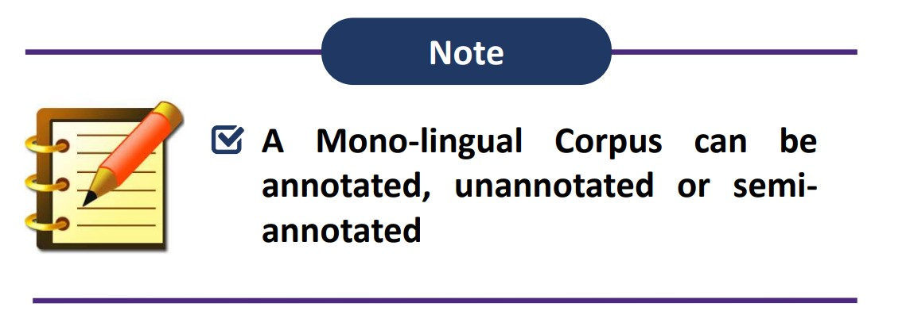
Types of Corpus / Dataset – NLP (Conti.)
Syntax and Semantics
Discourse & Speech
Dr. Rao Muhammad Adeel Nawab

Slide 19
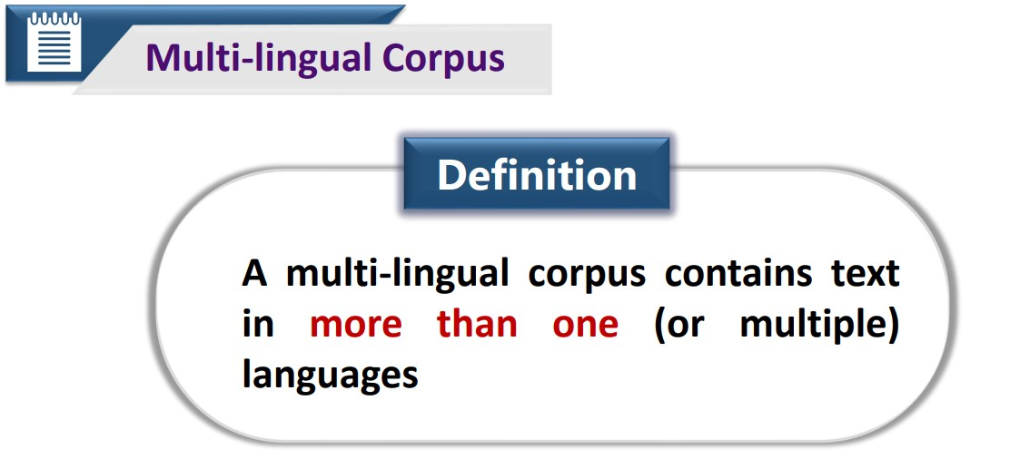
Types of Corpus / Dataset – NLP (Conti.)
Syntax and Semantics
Discourse & Speech
Dr. Rao Muhammad Adeel Nawab

Slide 20
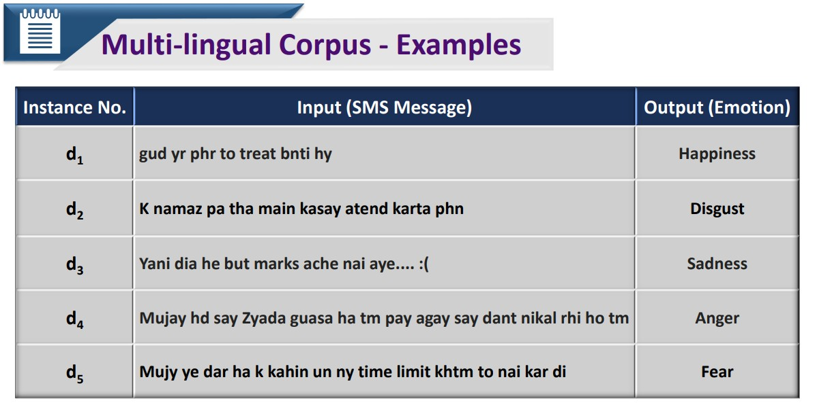
Types of Corpus / Dataset – NLP (Conti.)
Syntax and Semantics
Discourse & Speech
Dr. Rao Muhammad Adeel Nawab

Slide 21
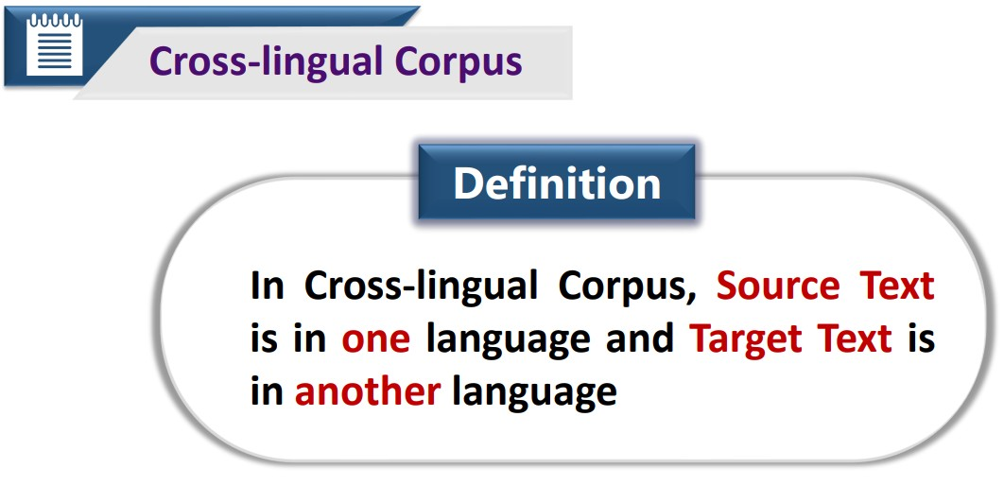
Types of Corpus / Dataset – NLP (Conti.)
Syntax and Semantics
Discourse & Speech
Dr. Rao Muhammad Adeel Nawab

Slide 22
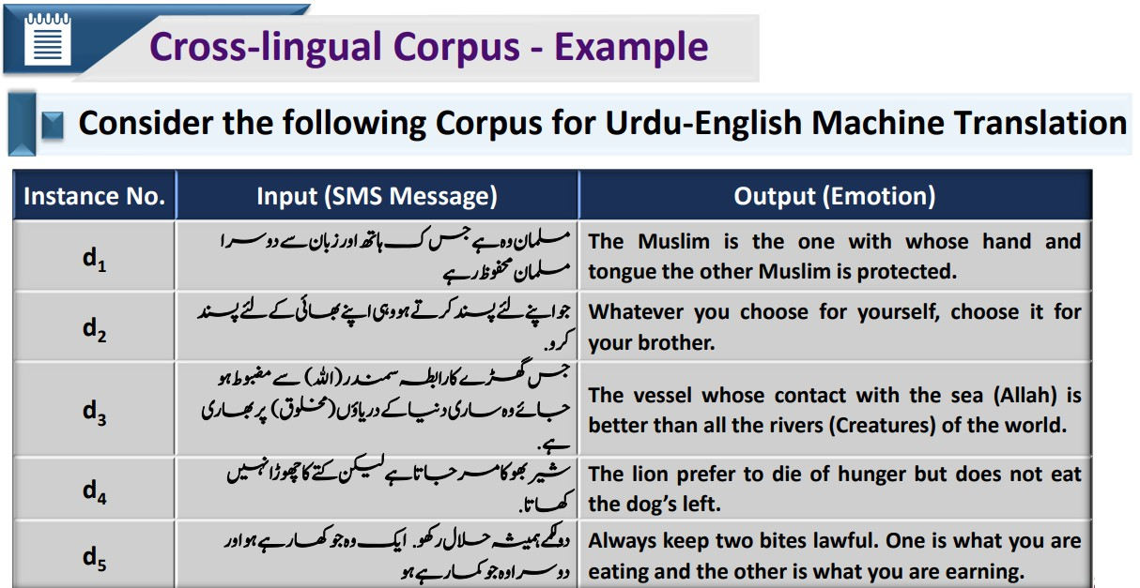
Types of Corpus / Dataset – NLP (Conti.)
Syntax and Semantics
Discourse & Speech
Dr. Rao Muhammad Adeel Nawab

Slide 23
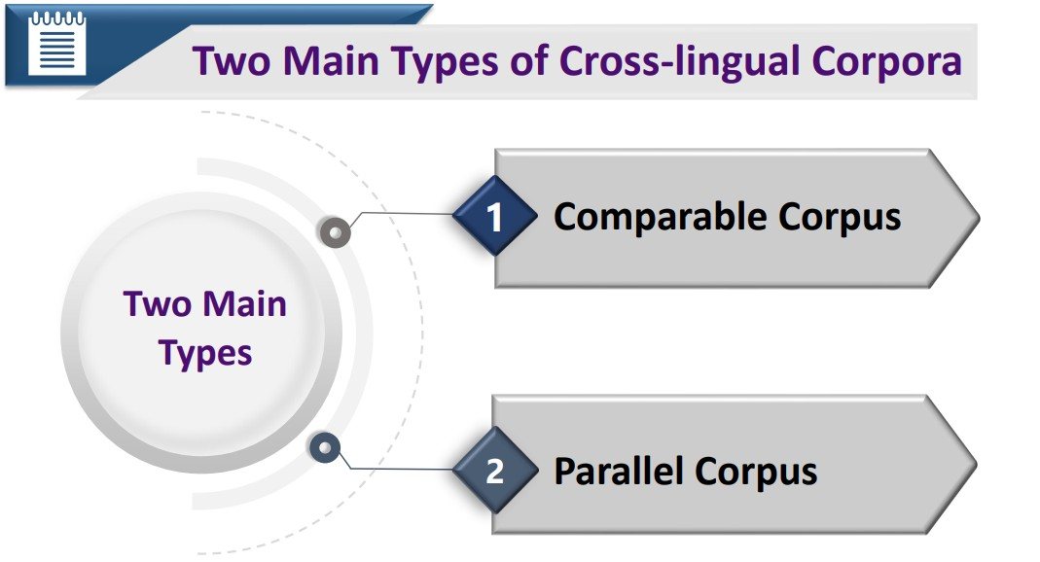
Types of Corpus / Dataset – NLP (Conti.)
Dr. Rao Muhammad Adeel Nawab

Slide 24
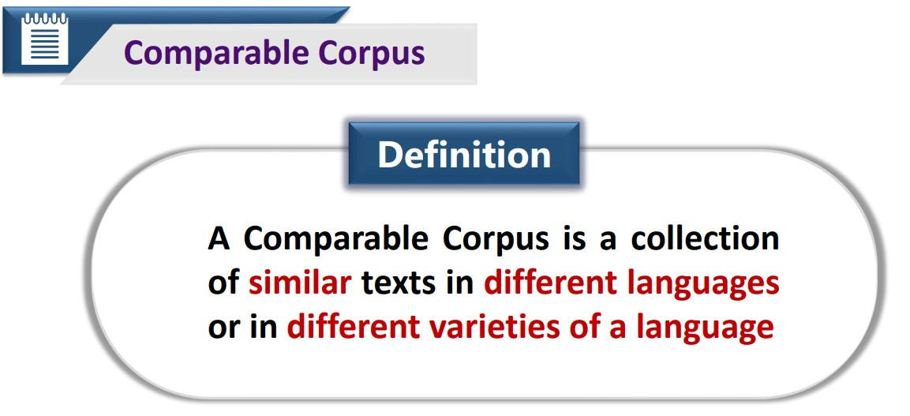
Types of Corpus / Dataset – NLP (Conti.)
Dr. Rao Muhammad Adeel Nawab

Slide 25
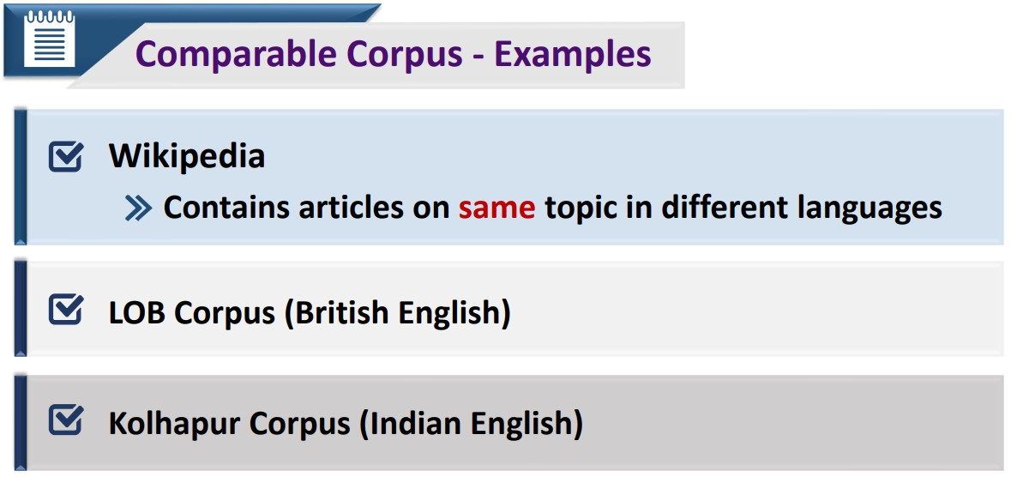
Types of Corpus / Dataset – NLP (Conti.)
Dr. Rao Muhammad Adeel Nawab

Slide 26
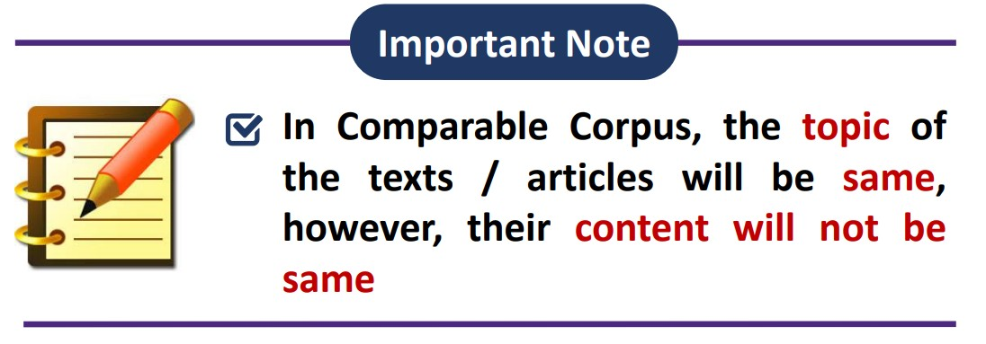
Types of Corpus / Dataset – NLP (Conti.)
Dr. Rao Muhammad Adeel Nawab

Slide 27
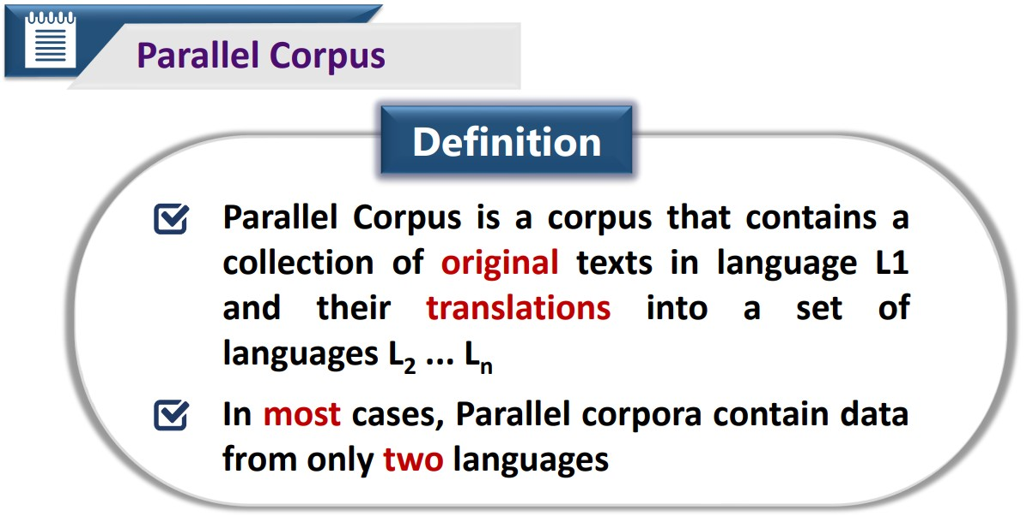
Types of Corpus / Dataset – NLP (Conti.)
Dr. Rao Muhammad Adeel Nawab

Slide 28
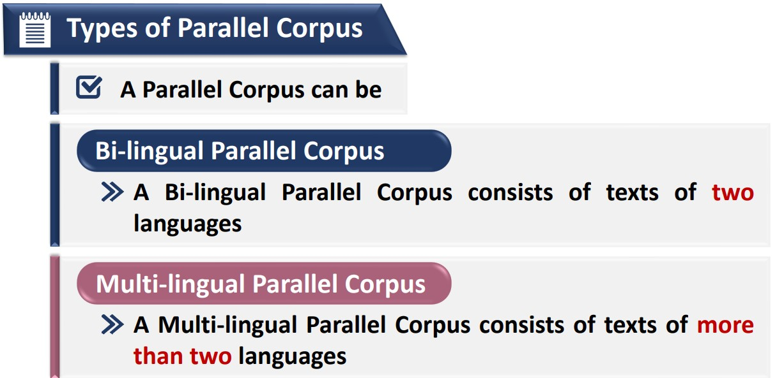
Types of Corpus / Dataset – NLP (Conti.)
Dr. Rao Muhammad Adeel Nawab

Slide 29
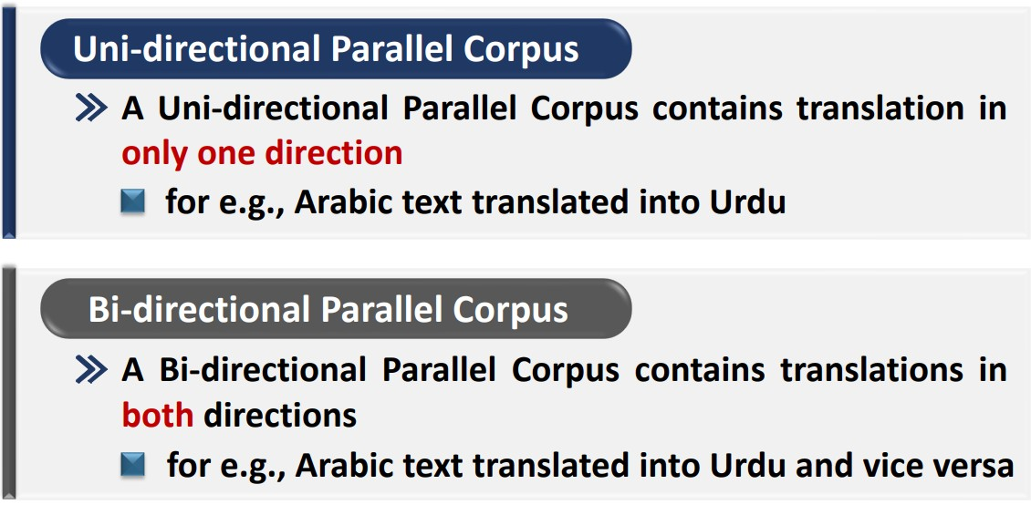
Types of Corpus / Dataset – NLP (Conti.)
Dr. Rao Muhammad Adeel Nawab

Slide 30
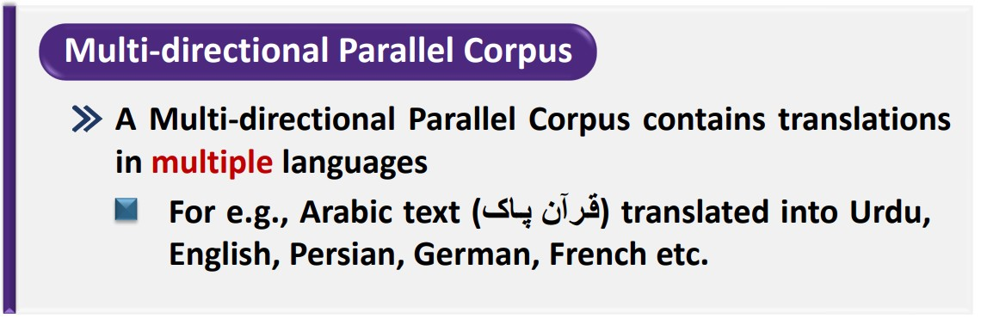
Types of Corpus / Dataset – NLP (Conti.)
Dr. Rao Muhammad Adeel Nawab

Slide 31
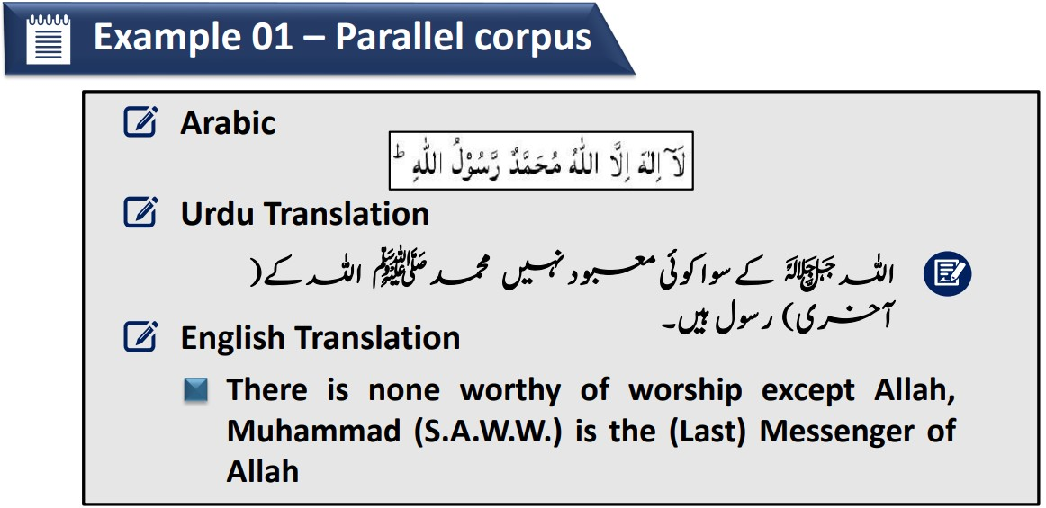
Types of Corpus / Dataset – NLP (Conti.)
Dr. Rao Muhammad Adeel Nawab

Slide 32
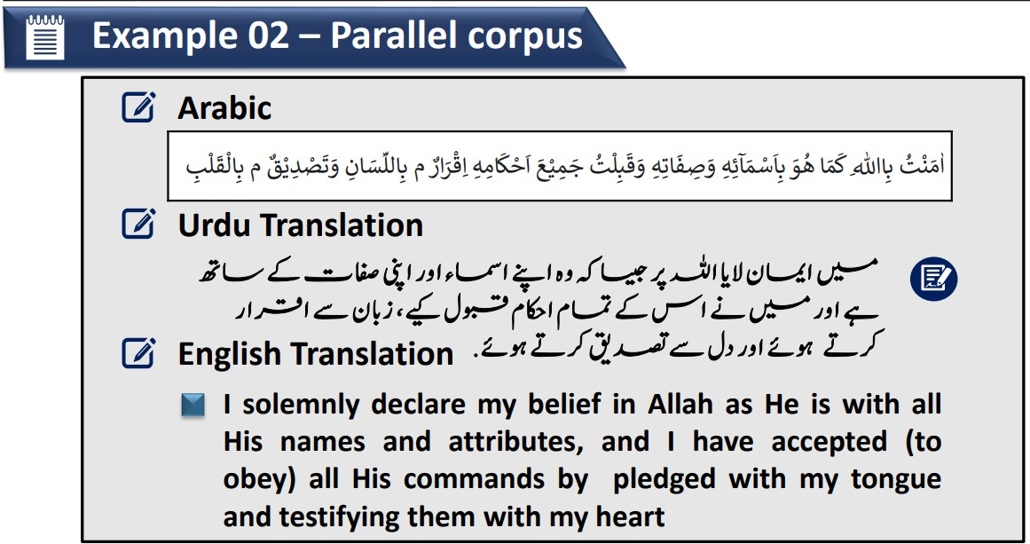
Types of Corpus / Dataset – NLP (Conti.)
Dr. Rao Muhammad Adeel Nawab

Slide 33
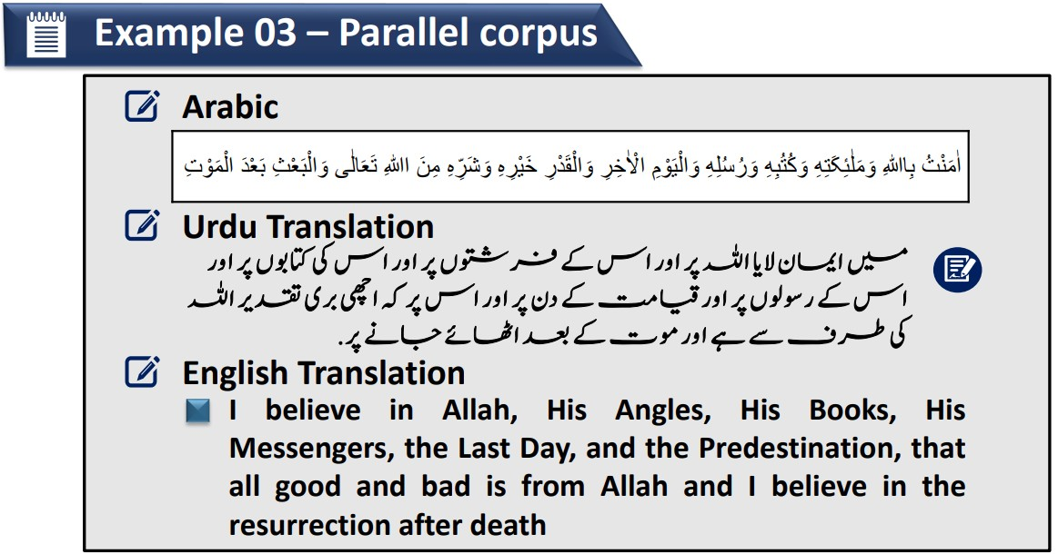
Types of Corpus / Dataset – NLP (Conti.)
Dr. Rao Muhammad Adeel Nawab

Slide 34
Data and Annotations
Dr. Rao Muhammad Adeel Nawab

Slide 35
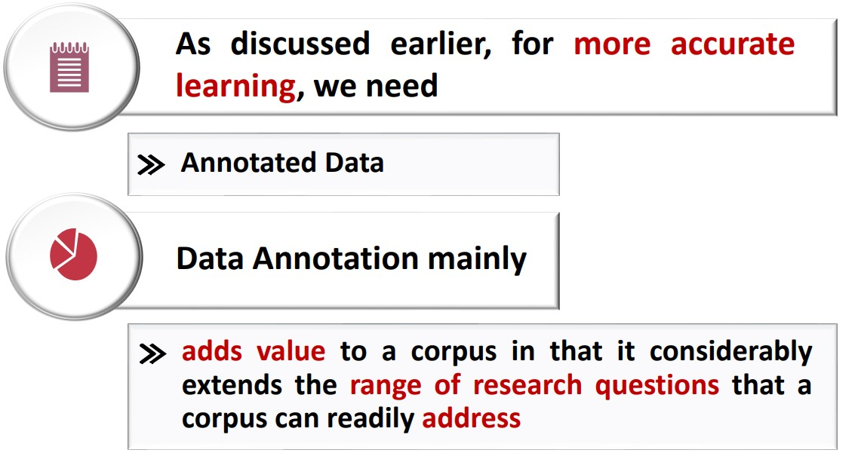
Advantages of Data Annotation – NLP
Dr. Rao Muhammad Adeel Nawab

Slide 36
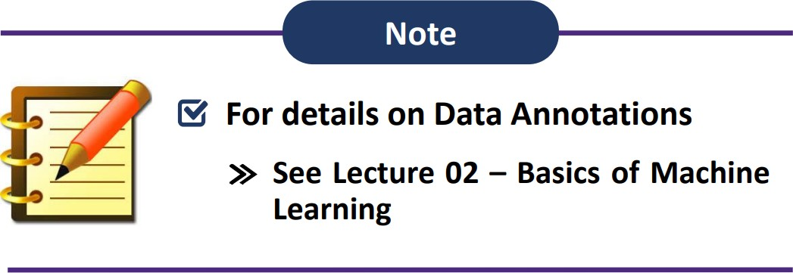
Advantages of Data Annotation – NLP (Conti.)
Dr. Rao Muhammad Adeel Nawab

Slide 37
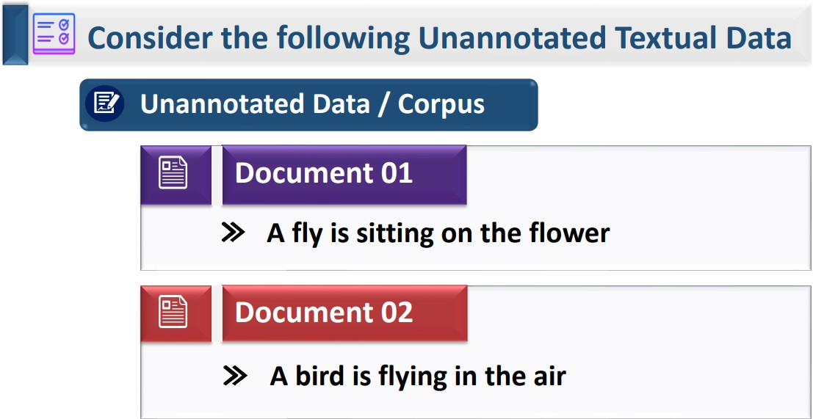
Example - Advantages of Data Annotation – NLP
Dr. Rao Muhammad Adeel Nawab

Slide 38
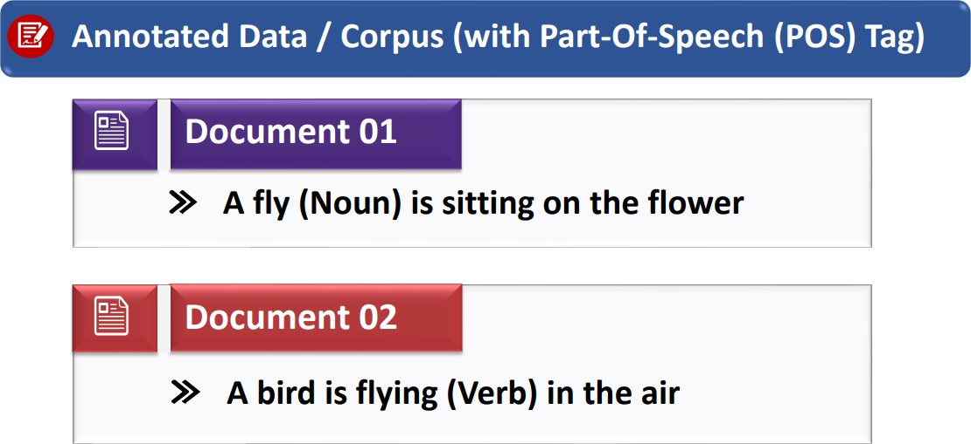
Example - Advantages of Data Annotation – NLP (Conti.)
Dr. Rao Muhammad Adeel Nawab

Slide 39
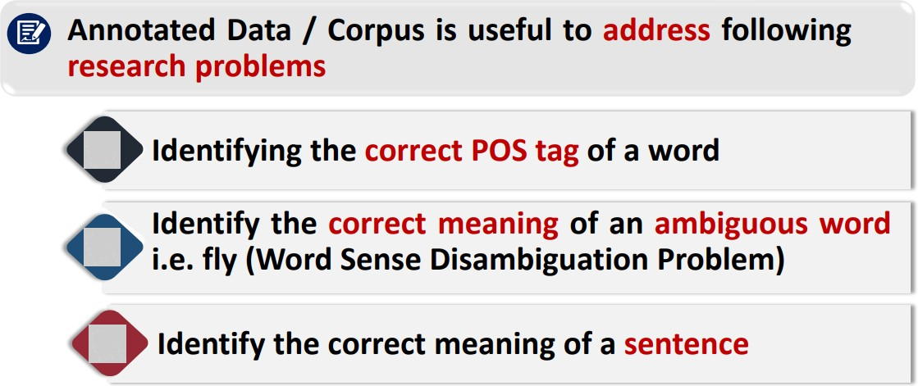
Example - Advantages of Data Annotation – NLP (Conti.)
Dr. Rao Muhammad Adeel Nawab

Slide 40
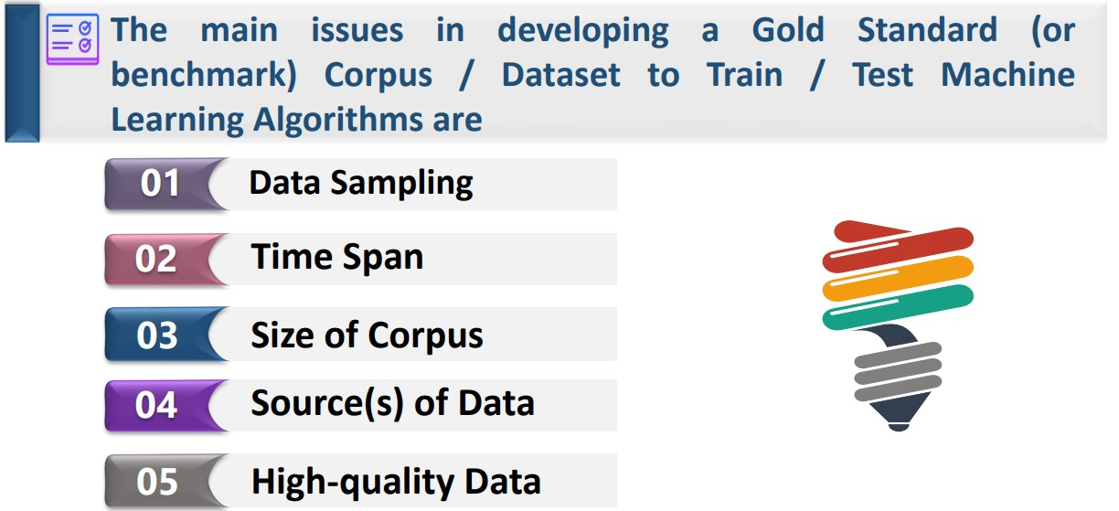
Annotated Corpus Development Issues
Dr. Rao Muhammad Adeel Nawab

Slide 41
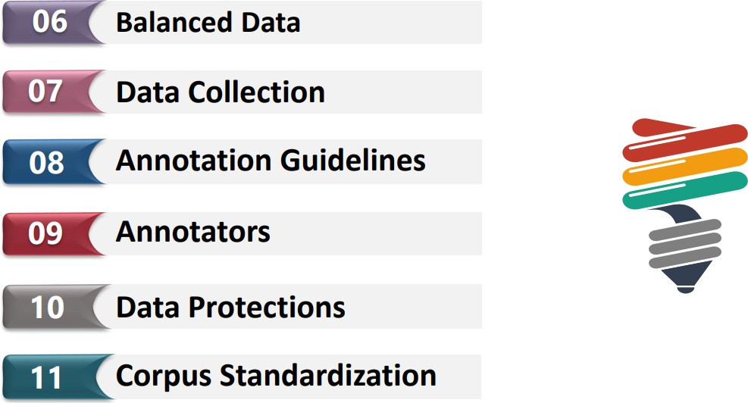
Annotated Corpus Development Issues (Conti.)
Dr. Rao Muhammad Adeel Nawab

Slide 42
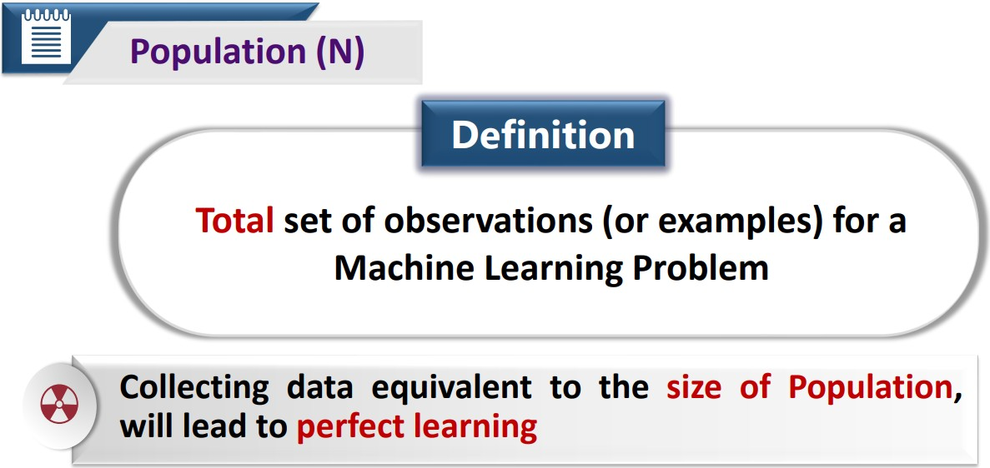
1: Data Sampling – Annotated Corpus Development Issues
Dr. Rao Muhammad Adeel Nawab

Slide 43
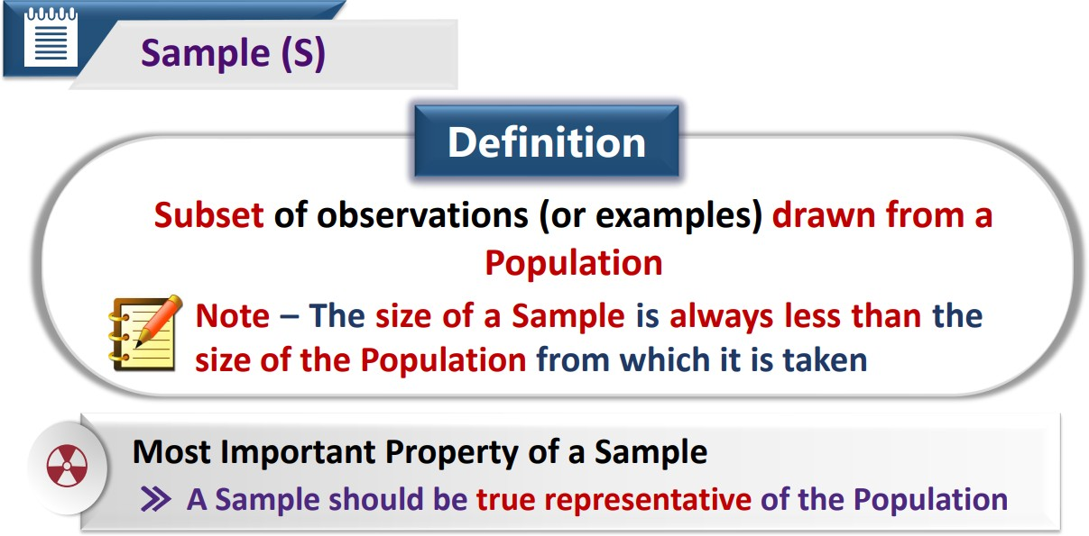
1: Data Sampling – Annotated Corpus Development Issues
Dr. Rao Muhammad Adeel Nawab

Slide 44
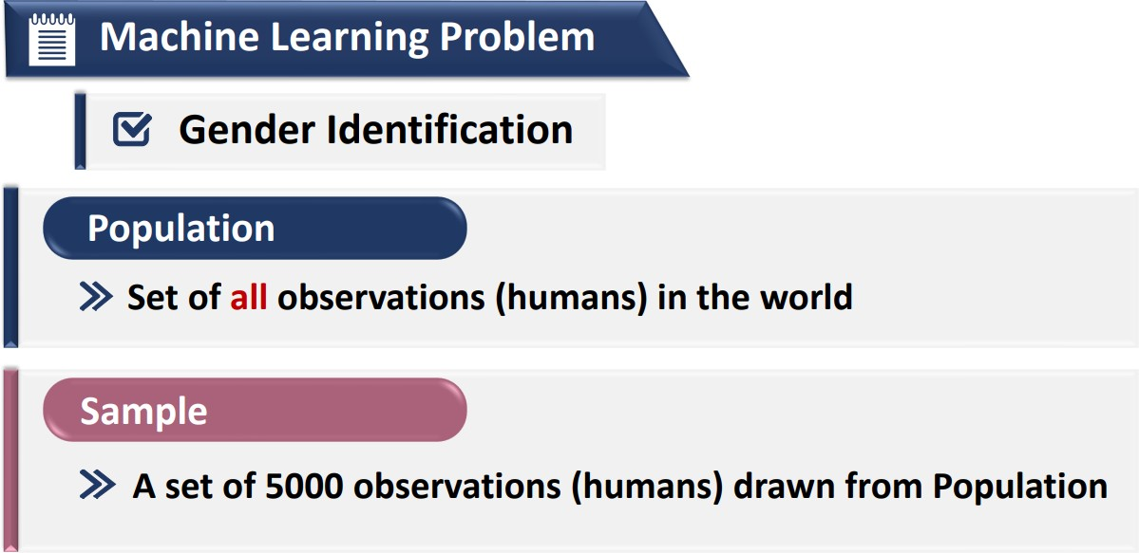
Example – Population and Sample
Dr. Rao Muhammad Adeel Nawab

Slide 45
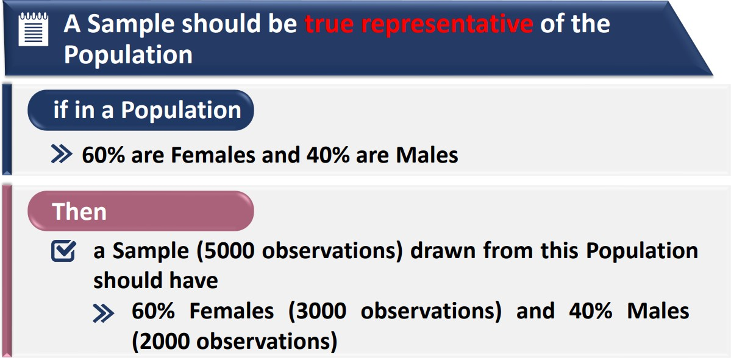
Example – Population and Sample Conti.
Dr. Rao Muhammad Adeel Nawab

Slide 46
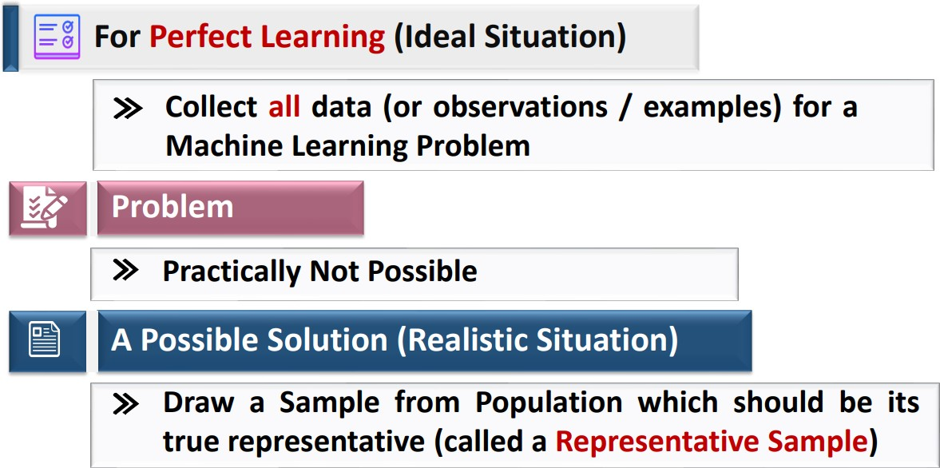
Why we need Data Sampling
Dr. Rao Muhammad Adeel Nawab

Slide 47
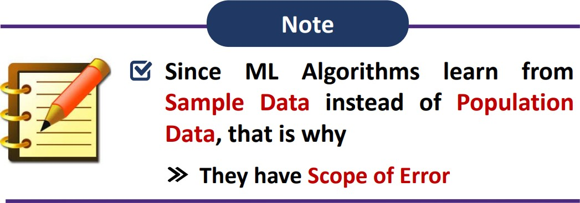
Why we need Data Sampling (Conti.)
Dr. Rao Muhammad Adeel Nawab

Slide 48
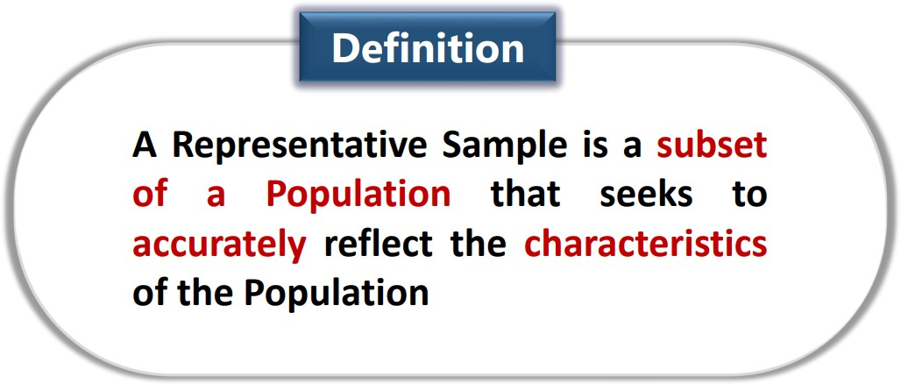
Representative Sample
Dr. Rao Muhammad Adeel Nawab

Slide 49
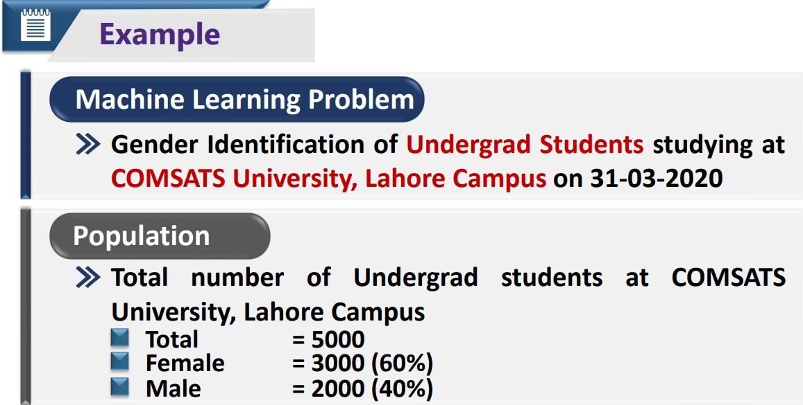
Representative Sample (Conti.)
Dr. Rao Muhammad Adeel Nawab

Slide 50
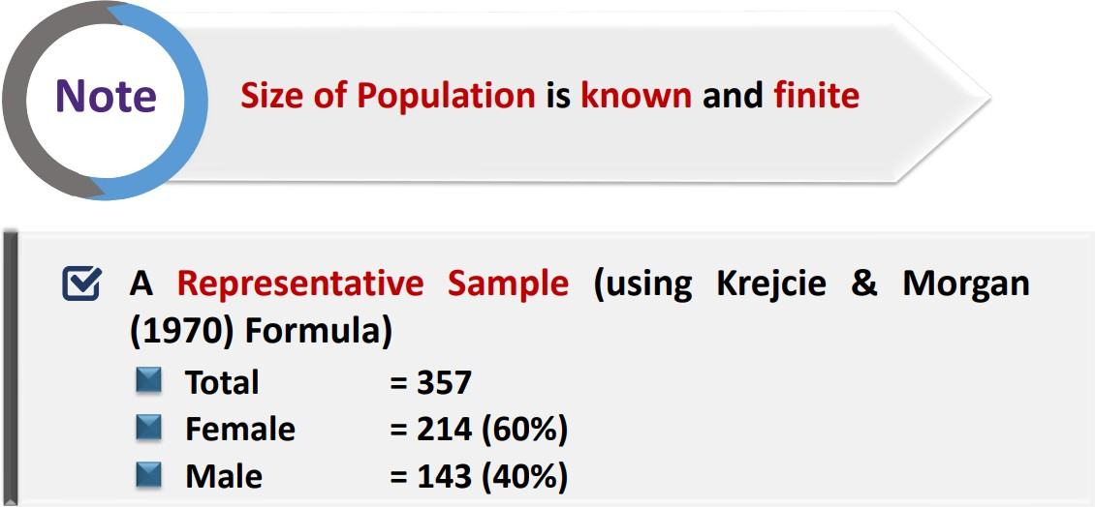
Representative Sample (Conti.)
Dr. Rao Muhammad Adeel Nawab

Slide 51
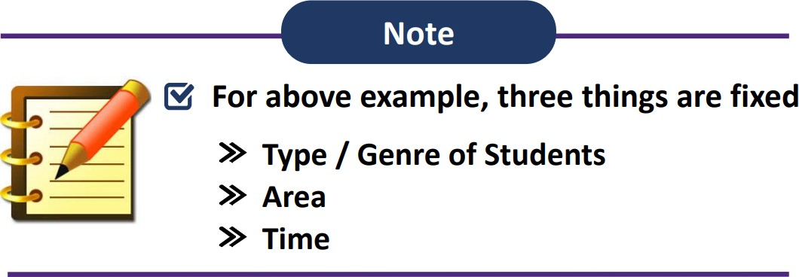
Why We Need Data Sampling?
Dr. Rao Muhammad Adeel Nawab

Slide 52
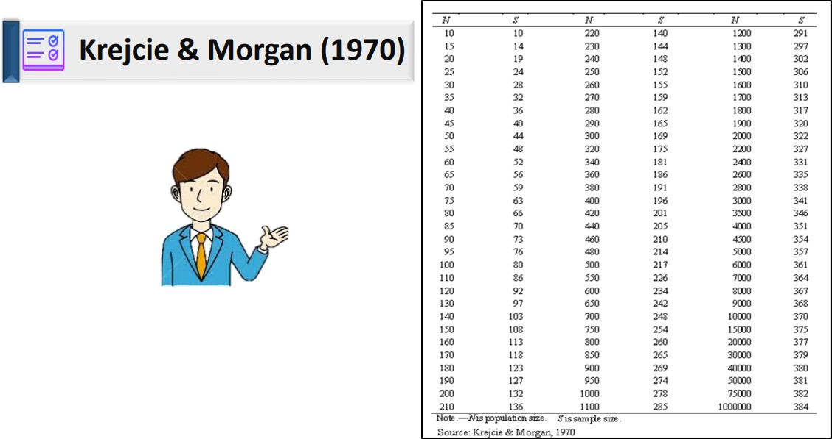
Table to Determine Sample Size for Finite Population
Dr. Rao Muhammad Adeel Nawab

Slide 53
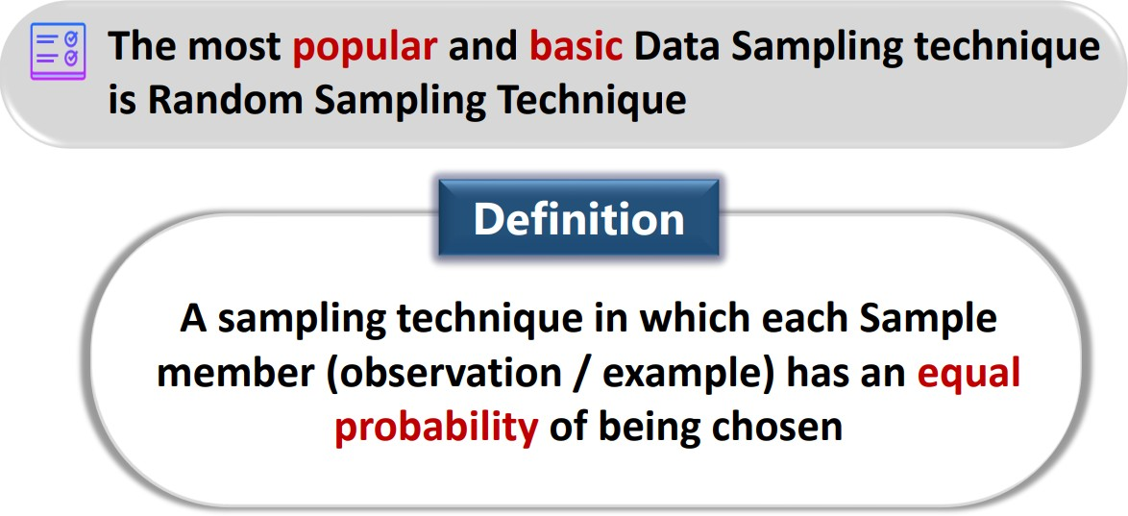
Random Sampling Technique
Dr. Rao Muhammad Adeel Nawab

Slide 54
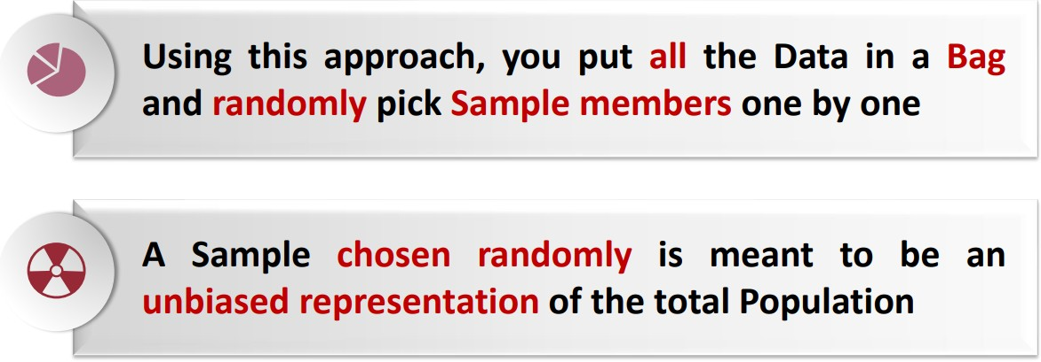
Random Sampling Technique (Conti.)
Dr. Rao Muhammad Adeel Nawab

Slide 55
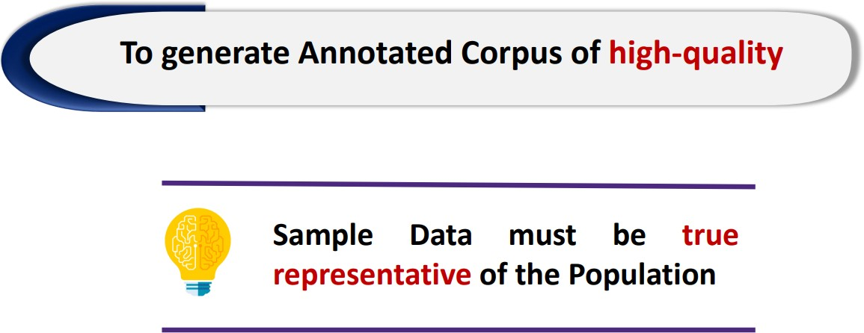
Data Sampling and Quality
Dr. Rao Muhammad Adeel Nawab

Slide 56
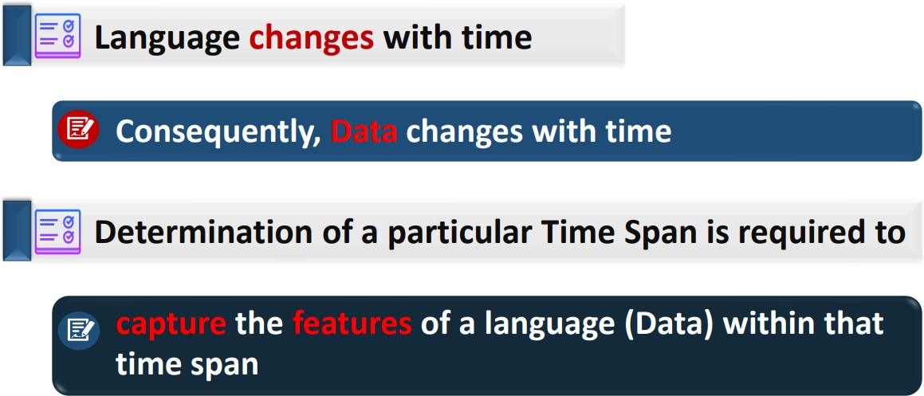
2: Time Span – Annotated Corpus Development Issues
Dr. Rao Muhammad Adeel Nawab

Slide 57

Example – How Data Changes Over Time
Dr. Rao Muhammad Adeel Nawab

Slide 58

Example – How Data Changes Over Time (Conti.)
Dr. Rao Muhammad Adeel Nawab

Slide 59

3: Size of Corpus – Annotated Corpus Development Issues
Dr. Rao Muhammad Adeel Nawab

Slide 60

3: Size of Corpus – Annotated Corpus Development Issues
Dr. Rao Muhammad Adeel Nawab

Slide 61

4: Sources(s) of Data – Annotated Corpus Development Issues
Dr. Rao Muhammad Adeel Nawab

Slide 62

4: Sources(s) of Data – Annotated Corpus Development Issues
Dr. Rao Muhammad Adeel Nawab

Slide 63

4: Sources(s) of Data – Annotated Corpus Development Issues
Dr. Rao Muhammad Adeel Nawab

Slide 64
4: Sources(s) of Data – Annotated Corpus Development Issues
Dr. Rao Muhammad Adeel Nawab

Slide 65

4: Sources(s) of Data – Annotated Corpus Development Issues
Dr. Rao Muhammad Adeel Nawab

Slide 66

4: Sources(s) of Data – Annotated Corpus Development Issues
Dr. Rao Muhammad Adeel Nawab

Slide 67

Types of Data Sources
Dr. Rao Muhammad Adeel Nawab

Slide 68

Types of Data Sources (Conti.)
Dr. Rao Muhammad Adeel Nawab

Slide 69

Types of Data Sources (Conti.)
Dr. Rao Muhammad Adeel Nawab

Slide 70

Types of Data Sources (Conti.)
Dr. Rao Muhammad Adeel Nawab

Slide 71

Types of Data Sources (Conti.)
Dr. Rao Muhammad Adeel Nawab

Slide 72

Example 01 – Sources with Annotations
Dr. Rao Muhammad Adeel Nawab

Slide 73

Example 01 – Sources with Annotations (Conti.)
Dr. Rao Muhammad Adeel Nawab

Slide 74

Example 01 – Sources with Annotations (Conti.)
Dr. Rao Muhammad Adeel Nawab

Slide 75

Example 01 – Sources with Annotations (Conti.)
Dr. Rao Muhammad Adeel Nawab

Slide 76

Example 02 – Sources with Annotations
Dr. Rao Muhammad Adeel Nawab

Slide 77

Example 02 – Sources with Annotations (Conti.)
Dr. Rao Muhammad Adeel Nawab

Slide 78

Example 02 – Sources with Annotations (Conti.)
Dr. Rao Muhammad Adeel Nawab

Slide 79

Example 02 – Sources with Annotations (Conti.)
Dr. Rao Muhammad Adeel Nawab

Slide 80

Example 02 – Sources with Annotations (Conti.)
Dr. Rao Muhammad Adeel Nawab

Slide 81

Example 02 – Sources with Annotations (Conti.)
Dr. Rao Muhammad Adeel Nawab

Slide 82

Example 01 – Sources without Annotations
Dr. Rao Muhammad Adeel Nawab

Slide 83

Example 01 – Sources without Annotations (Conti.)
Dr. Rao Muhammad Adeel Nawab

Slide 84

Example 01 – Sources without Annotations (Conti.)
Dr. Rao Muhammad Adeel Nawab

Slide 85

Example 01 – Sources without Annotations (Conti.)
Dr. Rao Muhammad Adeel Nawab

Slide 86

Example 01 – Sources without Annotations (Conti.)
Dr. Rao Muhammad Adeel Nawab

Slide 87

Example 01 – Sources without Annotations (Conti.)
Dr. Rao Muhammad Adeel Nawab

Slide 88
Example 01 – Sources without Annotations (Conti.)
Dr. Rao Muhammad Adeel Nawab

Slide 89

Example 02 – Sources without Annotations
Dr. Rao Muhammad Adeel Nawab

Slide 90

Example 02 – Sources without Annotations (Conti.)
Dr. Rao Muhammad Adeel Nawab

Slide 91

Example 02 – Sources without Annotations (Conti.)
Dr. Rao Muhammad Adeel Nawab

Slide 92

Example 02 – Sources without Annotations (Conti.)
Dr. Rao Muhammad Adeel Nawab

Slide 93

Example 02 – Sources without Annotations (Conti.)
Dr. Rao Muhammad Adeel Nawab

Slide 94

Example 02 – Sources without Annotations (Conti.)
Dr. Rao Muhammad Adeel Nawab

Slide 95

Comparing Annotations for Emotion Detection and
Machine Translation
Dr. Rao Muhammad Adeel Nawab

Slide 96

5: High-quality Data – Annotated Corpus Development
Issues
Dr. Rao Muhammad Adeel Nawab

Slide 97

5: High-quality Data – Annotated Corpus Development
Issues
Dr. Rao Muhammad Adeel Nawab

Slide 98

6: Balanced Data – Annotated Corpus Development Issues
Dr. Rao Muhammad Adeel Nawab

Slide 99

6: Balanced Data – Annotated Corpus Development Issues
Dr. Rao Muhammad Adeel Nawab

Slide 100

6: Balanced Data – Annotated Corpus Development Issues
Dr. Rao Muhammad Adeel Nawab
100

Slide 101

Example - Balanced Data
Dr. Rao Muhammad Adeel Nawab
100

Slide 102

Example - Balanced Data (Conti.)
Dr. Rao Muhammad Adeel Nawab
100

Slide 103

Example - Balanced Data Conti.
Dr. Rao Muhammad Adeel Nawab
100

Slide 104

Example - Balanced Data Conti.
Dr. Rao Muhammad Adeel Nawab
100

Slide 105

7: Data Collection – Annotated Corpus Development Issues
Dr. Rao Muhammad Adeel Nawab
100

Slide 106

7: Data Collection – Annotated Corpus Development Issues
Dr. Rao Muhammad Adeel Nawab
100

Slide 107

Selection of Suitable Data Collection Method
Dr. Rao Muhammad Adeel Nawab
100

Slide 108

Selection of Suitable Data Collection Method (Conti.)
Dr. Rao Muhammad Adeel Nawab
100

Slide 109

Selection of Suitable Data Collection Method (Conti.)
Dr. Rao Muhammad Adeel Nawab
100

Slide 110

Selection of Suitable Data Collection Method (Conti.)
Dr. Rao Muhammad Adeel Nawab
100

Slide 111

Example 01 – Data Formats
Dr. Rao Muhammad Adeel Nawab
100

Slide 112

Example 02 – Data Formats
Dr. Rao Muhammad Adeel Nawab
100

Slide 113

Example 03 – Data Formats
Dr. Rao Muhammad Adeel Nawab
100

Slide 114

Collecting Non-digital Data
Dr. Rao Muhammad Adeel Nawab
100

Slide 115

Converting Non-digital Data into Digital Data
Dr. Rao Muhammad Adeel Nawab
100

Slide 116

Converting Non-digital Data into Digital Data (Conti.)
Dr. Rao Muhammad Adeel Nawab
100

Slide 117

Converting Non-digital Data into Digital Data (Conti.)
Dr. Rao Muhammad Adeel Nawab
100

Slide 118

Converting Non-digital Data into Digital Data (Conti.)
Dr. Rao Muhammad Adeel Nawab
100

Slide 119

Converting Non-digital Data into Digital Data (Conti.)
Dr. Rao Muhammad Adeel Nawab
100

Slide 120

Collecting Digital Data
Dr. Rao Muhammad Adeel Nawab
100

Slide 121

Collecting Digital Data (Conti.)
Dr. Rao Muhammad Adeel Nawab
100

Slide 122

Collecting Digital Data (Conti.)
Dr. Rao Muhammad Adeel Nawab
100

Slide 123

Examples – Collecting Digital Data
Dr. Rao Muhammad Adeel Nawab
100

Slide 124

Examples – Collecting Digital Data
Dr. Rao Muhammad Adeel Nawab
100

Slide 125

Examples – Collecting Digital Data (Conti.)
Dr. Rao Muhammad Adeel Nawab
100

Slide 126

Examples – Collecting Digital Data (Conti.)
Dr. Rao Muhammad Adeel Nawab
100

Slide 127

Examples – Collecting Digital Data (Conti.)
Dr. Rao Muhammad Adeel Nawab
100

Slide 128

Examples – Collecting Digital Data (Conti.)
Dr. Rao Muhammad Adeel Nawab
100

Slide 129

Examples – Collecting Digital Data (Conti.)
Dr. Rao Muhammad Adeel Nawab
100

Slide 130

Examples – Collecting Digital Data (Conti.)
Dr. Rao Muhammad Adeel Nawab
100

Slide 131

8: Annotation Guidelines – Annotated Corpus Development Issues
Dr. Rao Muhammad Adeel Nawab
100

Slide 132

8: Annotation Guidelines – Annotated Corpus Development Issues
Dr. Rao Muhammad Adeel Nawab
100

Slide 133

9: Annotators – Annotated Corpus Development Issues
Dr. Rao Muhammad Adeel Nawab
100

Slide 134

Annotations are Present in Raw Data
Dr. Rao Muhammad Adeel Nawab
100

Slide 135

Annotations are Present in Raw Data (Conti.)
Dr. Rao Muhammad Adeel Nawab
100

Slide 136

Annotations are Not Present in Raw Data
Dr. Rao Muhammad Adeel Nawab
100

Slide 137

Annotations are Not Present in Raw Data (Conti.)
Dr. Rao Muhammad Adeel Nawab
100

Slide 138

Example – Annotations When Output is of Fixed Length
Dr. Rao Muhammad Adeel Nawab
100

Slide 139

Example – Annotations When Output is of Fixed Length
(Conti.)
Dr. Rao Muhammad Adeel Nawab
100

Slide 140

Example – Annotations When Output is of Fixed Length
(Conti.)
Dr. Rao Muhammad Adeel Nawab
100

Slide 141

Example – When Output is of Variable Length
Dr. Rao Muhammad Adeel Nawab
100

Slide 142
Example – When Output is of Variable Length
Dr. Rao Muhammad Adeel Nawab
100

Slide 143

Example – When Output is of Variable Length (Conti.)
Dr. Rao Muhammad Adeel Nawab
100

Slide 144

Example – When Output is of Variable Length (Conti.)
Dr. Rao Muhammad Adeel Nawab
100

Slide 145

Example – When Output is of Variable Length (Conti.)
Dr. Rao Muhammad Adeel Nawab
100

Slide 146

Example – When Output is of Variable Length (Conti.)
Dr. Rao Muhammad Adeel Nawab
100

Slide 147

10: Data Protection - Annotated Corpus Development
Issues
Dr. Rao Muhammad Adeel Nawab
100

Slide 148

Data Protection - Annotated Corpus Development
Dr. Rao Muhammad Adeel Nawab
100

Slide 149

Data Protection - Annotated Corpus Development (Conti.)
Dr. Rao Muhammad Adeel Nawab
100

Slide 150

Data Protection - Annotated Corpus Development (Conti.)
Dr. Rao Muhammad Adeel Nawab
100

Slide 151

Data Protection - Annotated Corpus Development (Conti.)
Dr. Rao Muhammad Adeel Nawab
100

Slide 152

Example - Corpus containing both Private and Public Data
Dr. Rao Muhammad Adeel Nawab
100

Slide 153

License and Annotated Corpus Development
Dr. Rao Muhammad Adeel Nawab
100

Slide 154

License and Annotated Corpus Development (Conti.)
Dr. Rao Muhammad Adeel Nawab
100

Slide 155

License and Annotated Corpus Development (Conti.)
Dr. Rao Muhammad Adeel Nawab
100

Slide 156

11: Corpus Standardization – Annotated Corpus
Development Issues
Dr. Rao Muhammad Adeel Nawab
100

Slide 157

Main Characteristics of a Gold Standard Annotated Corpus
Dr. Rao Muhammad Adeel Nawab
100

Slide 158

Main Characteristics of a Gold Standard Annotated Corpus (Conti.)
Dr. Rao Muhammad Adeel Nawab
100

Slide 159

Main Characteristics of a Gold Standard Annotated Corpus (Conti.)
Dr. Rao Muhammad Adeel Nawab
100

Slide 160

Main Characteristics of a Gold Standard Annotated Corpus (Conti.)
Dr. Rao Muhammad Adeel Nawab
100

